Slide 1
FUNDAMENTALS OF PROGRAMMING
Lecture 9: ARRAYS
Instructor: Dr Aqib Perwaiz
DEPARTMENT OF COMPUTER ENGINEERING
COLLEGE OF E&ME

Slide 2
FUNDAMENTALS OF PROGRAMMING
CS-114
Lecture 9

Slide 3
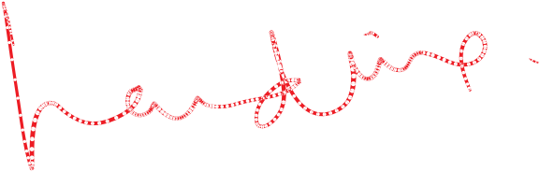


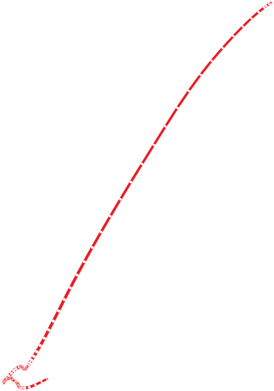
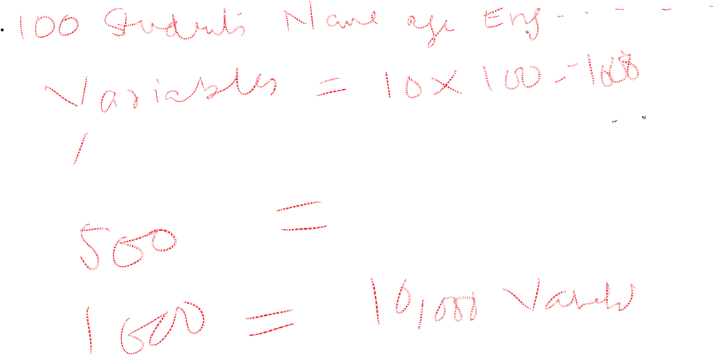


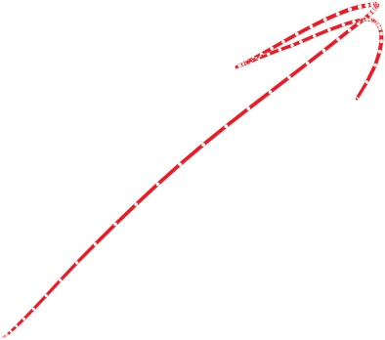

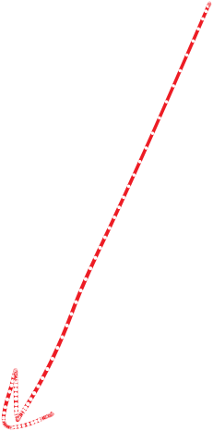
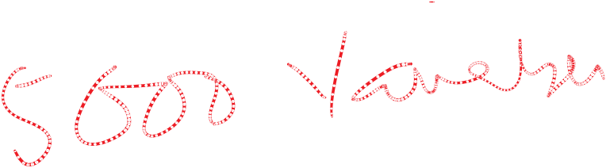

Slide 4


Arrays
An array is a collection of variables of similar type, placed contiguously in memory.
Arrays are used to avoid the inconvenience of giving each data element a unique variable name.
One data structure having more than one data members of the same type

Slide 5



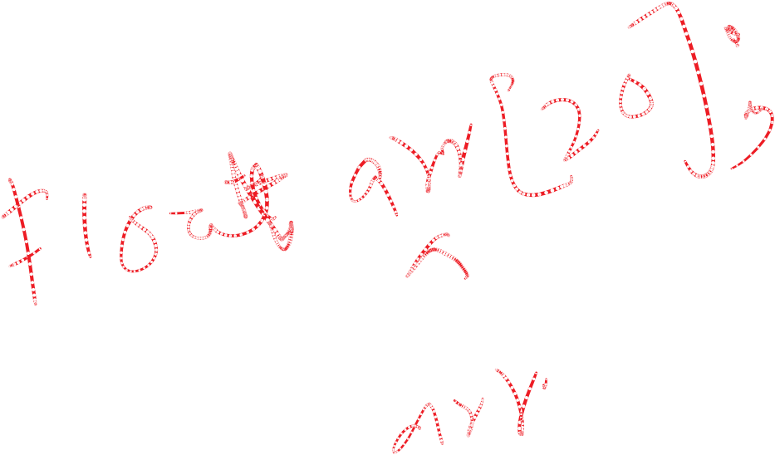

Array Definition
Array declaration tells the compiler about
  the type of array.
  the name of array.
  the size of array.
type arrayName [ arraySize ];
Example:
float arr[ 20 ];
Array type Array name
Array size

Slide 6
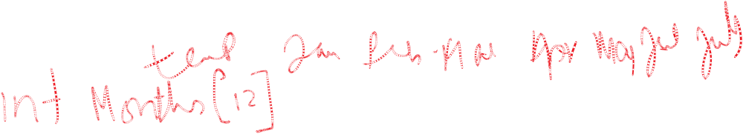
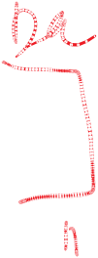

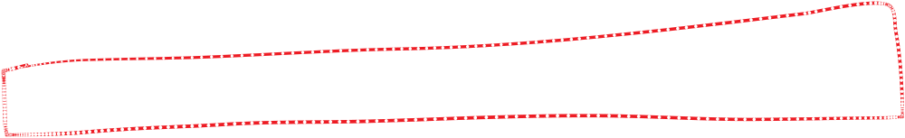
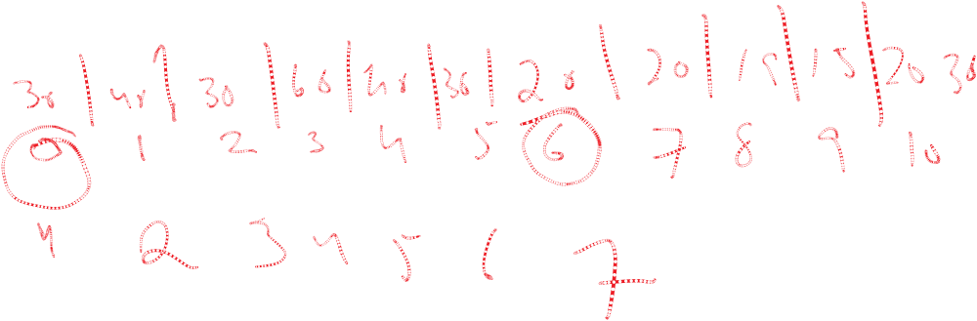



Referring to Individual Elements in an Array
All the array elements are numbered, starting at 0 -> arr[0], arr[1], arr[2], etc
The last array element is one less than the size of the array.
– If array size is 20, ie. arr[20] array subscripts would be from
arr[0] arr[19]
to

Slide 7
Referring to Individual Elements in an Array
Individual elements of the array are referred to with subscripts, the number in brackets following the array name
  To use the 2nd element of the array ->arr[1]
  To use the 1st element of the array -> arr[0]
  To use the 9th element of the array -> arr[8]

Slide 8
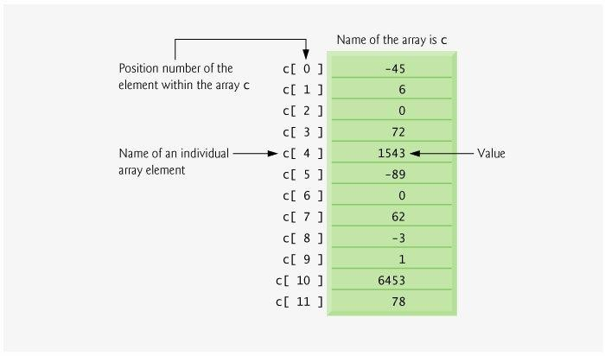
Example
Integer Type Array
Size of Array = 12
Each element in the array is an integer
(Deitel and Deitel)

Slide 9
Initializing Arrays
/* integer type array */
int rooms [5] = { 50, 49, 20, 1, 17};
/* float type array */
float length [4] = { 12.39, 16.5,
15.3, 0.23};
/* character type array */
char name [4] = { ‘a’, ‘A’, ‘z’, ‘Z’};

Slide 10
Initializing Arrays
/*declared but uninitialized
int n[10];
/* initialize elements of array n with 0 int n[ 10 ] = {}; OR
int n[ 10 ] = { 0 };
/*creates a five-element array. int n[ ] = { 1, 2, 3, 4, 5 };

Slide 11
Initializing Arrays
If the array size and an initializer list are specified in an array declaration and the number of initializers are greater than the array size.
For example the array declaration
int n[5] = { 32, 27, 64, 18, 95, 14 };
  causes a compilation error, because there are six initializers and only five array elements.

Slide 12
Initializing Arrays
If the array size and an initializer list are specified in an array declaration and the number of initializers is lesser than the array size.
For example the array declaration
int n[5] = { 32, 27, 64 };
it will fill the remaining array positions with 0
32 | 27 | 64 | 0 | 0

Slide 13
Entering Data into an Array
Data can be entered into individual elements of an array using a loop
Enter marks of five students into an array
int marks[5];
for ( int i = 0; i < 5; i++ )
{
cout << "Enter marks of " <<i+1 <<" student = ";
cin >> marks [i] ;
}

Slide 14
Reading Data from an Array
Reading data from the array “marks” and calculating the average.
sum = 0;
for ( i = 0; i < 5; i++ ) sum += marks [i];
cout<<"Average is "<<sum/5<<endl;

Slide 15
Summing the Elements of an Array
int main()
{
const int Size = 10; //variable indicating
size of array
int a[Size] = {87,68,94,100,83,78,85,91,76,87};
int total = 0;
// sum contents of array a
for ( int i = 0; i < Size; i++ ) total += a[ i ];
cout << "Total of array elements: " << total <<
endl; return 0;
}
Total of array elements: 849

Slide 16
Const variable
Constant variables must be initialized with a constant value (or expression) when they are declared and cannot be modified thereafter.
Constant variables are also called read-only variables.
Only constant variables can be used to declare the size of arrays.

Slide 17
Caution!
•
Referring to an element outside the array bounds is an
semantic error. It is not a syntax error.
– i.e. it is not caught by the compiler
When looping through an array, the array subscript should never go below 0 and should always be less than the total number of elements in the array (one less than the size of the array).
•
•
Make sure that the loop-termination condition prevents accessing elements outside this range.

Slide 18
Example
// Program to copy the contents of one array to another int main()
{
int oldMarks[4] = {78, 92, 56, 67};
int newMarks[4];
for(int i=0; i<4; i++) newMarks[i] = oldMarks[i];
cout<< "New array is : "<< endl;
for(int i=0; i<4; i++) cout<<"new Marks ["<<i<<"] :
"<<newMarks[i]<<endl;
return 0;
}

Slide 19
Example
Given array is:
22 91 35 78 10 8 75 99 1 67
1 8 10 22 35 67 75 78 91 99
#include <iostream>using namespace std;
int main() { int a[10] = { 22, 91, 35, 78, 10, 8, 75, 99, 1, 67 };
cout<<"Given array is:"<<endl;
for (int i = 0; i < 10; i++)
cout<< a[i] <<" ";
cout<<endl; int temp,i,n;
for (int i = 0; i < 9; i++)
{ for (int j = i + 1; j < 10; j++)
{ if (a[j] < a[i]) { temp = a[i]; a[i] = a[j];
a[j] = temp;
} } } for (int i = 0; i < 10; i++) cout<< a[i] <<" ";
return 0;}

Slide 20
Multi Dimensional Arrays (Matrices)
An array can have two or more dimensions. This permits them to model multidimensional objects, such as graph paper or the computer display screen.
They are often used to represent tables of values consisting of information arranged in rows and columns.

Slide 21
Multi Dimensional Arrays (Matrices)
To identify a particular element, we must specify two subscripts. By convention,
array_name[row_number][col_number]
  For example,
arr[i][j]

Slide 22
Multiple-Subscripted Arrays
19
Multiple subscripted arrays
  Tables with rows and columns (m by n array)
  Like matrices: specify row, then column
Column
Column 1
Column
Column 3
a[ 0 ][ 0 ]
a[ 0 ][ 1 ]
a[ 0 ][ 2 ]
a[ 0 ][ 3 ]
Row 0
Row 1
Row 2
0
2
a[ 1 ][ 0 ]
a[ 1 ][ 1 ]
a[ 1 ][ 2 ]
a[ 1 ][ 3 ]
a[ 2 ][ 0 ]
a[ 2 ][ 1 ]
a[ 2 ][ 2 ]
a[ 2 ][ 3 ]
Column
subscript
Array
name
Row subscript

Slide 23
6.9 Multiple-Subscripted Arrays
20
int
a[3][4];
Column
Column 1
Column
Column 3
a[ 0 ][ 0 ]
a[ 0 ][ 1 ]
a[ 0 ][ 2 ]
a[ 0 ][ 3 ]
Row 0
Row 1
Row 2
0
2
a[ 1 ][ 0 ]
a[ 1 ][ 1 ]
a[ 1 ][ 2 ]
a[ 1 ][ 3 ]
a[ 2 ][ 0 ]
a[ 2 ][ 1 ]
a[ 2 ][ 2 ]
a[ 2 ][ 3 ]
Column
subscript
Array
name
Row subscript

Slide 24
6.9 Multiple-Subscripted Arrays
21
Initialization
– int b[ 2 ][ 2 ] = { { 1, 2 }, { 3, 4 } };
– Initializers grouped by row in braces
b[0][0]
b[0][1]
1 | 2
3 | 4
b[1][0]
b[1][1]

Slide 25
6.9 Multiple-Subscripted Arrays
22
Initialization
– int b[ 2 ][ 2 ] = { { 1, 2 }, { 3, 4 } };
  Initializers grouped by row in braces
  If not enough, unspecified elements set to zero
int b[ 2 ][ 2 ] = { { 1 }, { 3, 4 } };
Referencing elements
  Specify row, then column
cout<<b[ 0 ][ 1 ] ;
1 | 2
3 | 4
1 | 0
3 | 4

Slide 26
Initializing a 2D Array
int matrix [10] [2] = { {59 , 78},
{14 , 17},
{68 , 28},
{32 , 45},
{ 5 , 14},
{12 , 15},
{ 6, 2},
1},
{ 22,
{14 , 16},
{ 2, 58} };
The values used to initialize an array are separated by commas and surrounded by braces.

Slide 27
2-D Array (Matrix)
int matrix [4] [4] = { {59, 78,14, 17},{68, 28,32, 45},
{5, 14,12, 15} ,{6, 2, 22, 1} };
59 (0,0) | 78 (0,1) | 14 (0,2) | 17 (0,3)
68 (1,0) | 28 (1,1) | 32 (1,2) | 45 (1,3)
5 (2,0) | 14 (2,1) | 12 (2,2) | 15 (2,3)
6 (3,0) | 2 (3,1) | 22 (3,2) | 1 (3,3)
(row = 2, col = 0)
4 x 4 Matrix

Slide 28
Reading a 2D Array
int matrix [4][4]={{59,78,14,17},{68,28,32,45},
{5, 14,12,15},{6,2, 22, 1}};
for(int i=0;i<4;i++)
{
for(int j=0;j<4;j++)
{
cout<<matrix[i][j]<<"\t";
}
cout<<endl;
}

Slide 29
Example
Write a matrix with following entries
 | 12
54 | 34
16 | 3
12 | 6
43 | 23
1 | 2

Slide 30
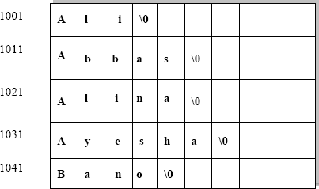
2D String
2D array of characters

Slide 31
1 /* Fig. 6.21: fig06_21.c
28
2 | Initializing multidimensional arrays */
3 | #include <stdio.h>
4
5 | void printArray( const int a[][ 3 ] ); /* function prototype | */
6
7 | /* function main begins program execution */
8 | int main()
9 | {
10 | /* initialize array1, array2, array3 */
11 | int | array1[ | 2 | ][ | 3 | ] | = | { | { 1, 2, 3 }, { 4, 5, | 6 | } | };
12 | int | array2[ | 2 | ][ | 3 | ] | = | { | 1, 2, 3, 4, 5 };
13 | int | array3[ | 2 | ][ | 3 | ] | = | { | { 1, 2 }, { 4 } };
14
15 | cout<<"Values in array1 | by | row | are:\n" | ;
16 | printArray( array1 );
17
18 | cout<<"Values in array2 | by | row | are:\n" | ;
19 | printArray( array2 );
20
21 | cout<<"Values in array3 | by | row | are:\n" | ;
22 | printArray( array3 );
23
24
25
26 } /* end main */
27
return 0; /* indicates successful termination */

Slide 32
28 /* function to output array with two rows and three columns */
29
30
31
32
33
34
35
36
37
38
39
40
41
42
43
44
45
29
void printArray( const int a[][ 3 ] )
{
int | i; | /* | counter | */
int | j; | /* | counter | */
/* loop through rows */
for ( i = 0; i <= 1; i++ ) {
/* output column values */
for ( j = 0; j <= 2; j++ ) {
cout<<a[ i ][ j ] ;
} /* end inner for */
cout<<"\n" ; /* start new line of output */
} /* end outer for */
Program Output
} /* end function printArray */
Values | in | array1 | by | row | are:
1 2 3
4 5 6
Values | in | array2 | by | row | are:
1 2 3
4 5 0
Values | in | array3 | by | row | are:
1 2 0
4 0 0

Slide 33
Examples Using Arrays
30
Character arrays
Its is used in programming for storing and manipulating text, such as words, names and sentences.
  Character arrays can be initialized using string literals
char string1[] = "first";
    Null character '\0' terminates strings
string1 actually has 6 elements
– It is equivalent to
char string1[] = { 'f', 'i', 'r', 's', 't', '\0' };
– Can access individual characters
string1[ 3 ] is character ‘s’

Slide 34
Character arrays
Like all other variables and arrays
char name[5]; cin >> name;
cout<< "you entered " << name;
The << operator displays the output until it encounters a null character.
In case of a string variable, the cin operator places the null automatically.

Slide 35
Multi-Dimensional Strings (Array of Strings)
char stu_lists [5] [10] = {“Ali”,
“Abbas”,
“Alina”,
“Ayesha”,
“Bano”,
};

Slide 36
Passing Elements of an Array to a Function
Arrays are passed
– By Reference

Slide 37
Passing Arrays to Functions
Passing arrays
  To pass an array argument to a function, specify the name of
the array without any brackets
int myArray[ 24 ]; myFunction( myArray, 24 );
    Array size usually passed to function
  Arrays passed call-by-reference
  Name of array is address of first element
  Function knows where the array is stored
    Modifies original memory locations
Passing array elements
  Passed by call-by-value
  Pass subscripted name (i.e., myArray[ 3 ]) to function
34

Slide 38
Passing Arrays to Functions
Function prototype
void modifyArray( int b[], int arraySize );
  Parameter names optional in prototype only
    int b[] could be written int []
    int arraySize could be simply int
  The following are equivalent prototypes:
void modifyArray( int b[], int arraySize );
void modifyArray( int [], int );
35

Slide 40
Acknowledgements
Deitel and Deitel: C++ How to Program, 7th Edition, Prentice Hall Publications
Robert Lafore: Object-Oriented Programming in C++, Fourth Edition, December 2001,Sams Publishing .
A Structured Programing Approach Using C++ by Behrouz A. Forouzan
www.cplusplus.com
Material in these slides has been taken from, the following resources

